Slide 1
Neuro-bubbles Data
June 12th, 2024

Slide 2


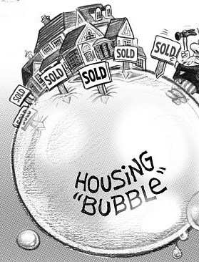
Financial Bubbles

Slide 3
What is a financial bubble
A bubble is an economic cycle that is characterized by the rapid escalation of market value, particularly in the price of assets. This fast inflation is followed by a quick decrease in value, or a contraction, that is sometimes referred to as a "crash" or a "bubble burst."

Slide 4
Bubble Literature Experimental Finance
Irrational exuberance and neural crash warning signals during endogenous experimental market bubbles (2014 Smith, Camerer, et al.)
Price bubbles, gender, and expectations in experimental asset markets (2017 Holt, Porizo, Song)
Gazing through the bubble: an experimental investigation into financial risk-taking using eye-tracking(2023 Toma, et al.)
A hybrid neuro-experimental decision support system to classify overconfidence and performance in a simulated bubble using a passive BCI (2023 Toma)

Slide 5
Experimental Design

Slide 6
Experimental Design
Asset Bubble Formation
Asset Price Forecasting
Risk Elicitation Task

Slide 7
Asset Bubble Formation
Experimental asset market where subjects trade a risky asset in an open-call market for 30 periods (Smith et al., 2014).
Market Structure
33 Trading Periods (3 practice)
15-25 simultaneous participants
5 In-Lab
10-20 online participants

Slide 8
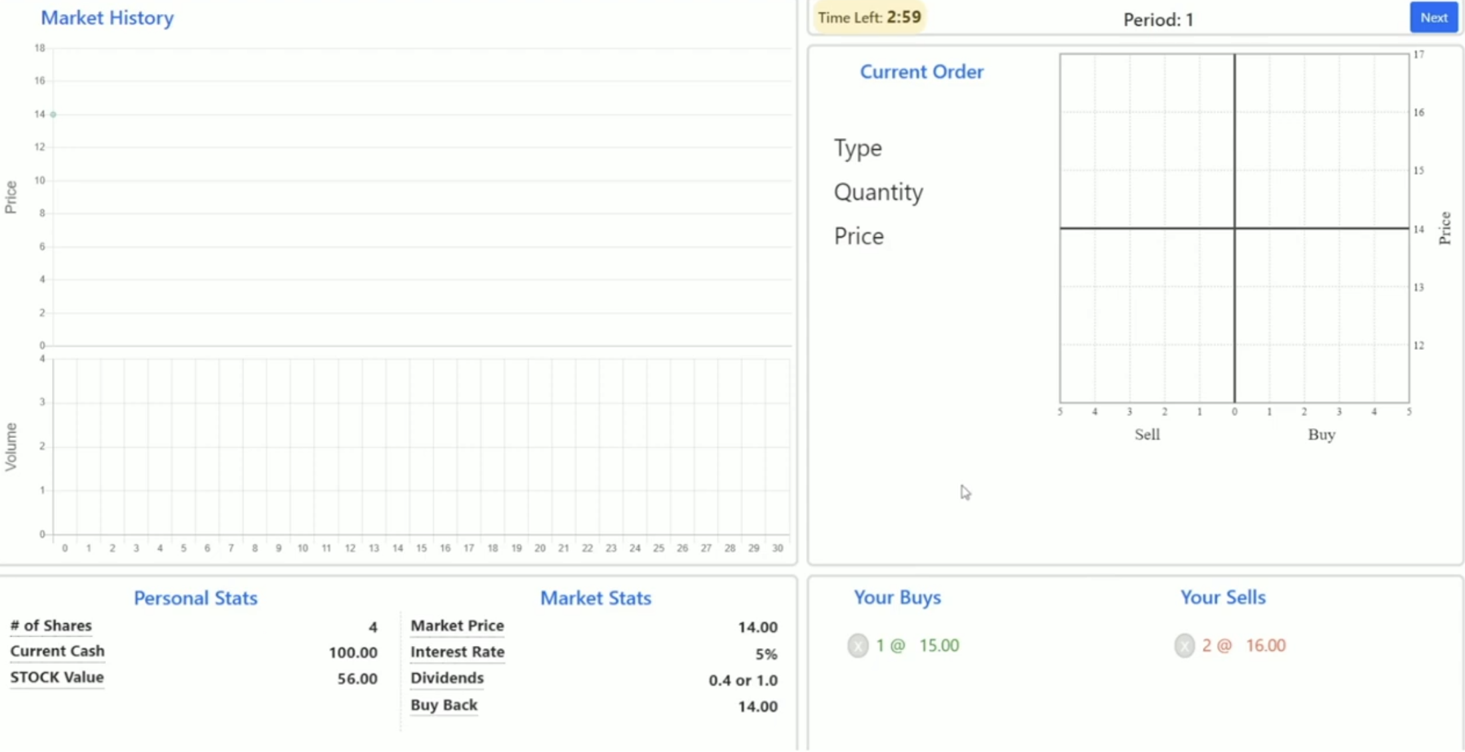
Asset Bubble Formation
Asset Endowment
140 units of CASH
4 units of Risky Asset
Interest/Dividend
CASH: 5% every trading period
Risky Asset: Dividends of either 0.4 or 1 with equal probability.

Slide 9
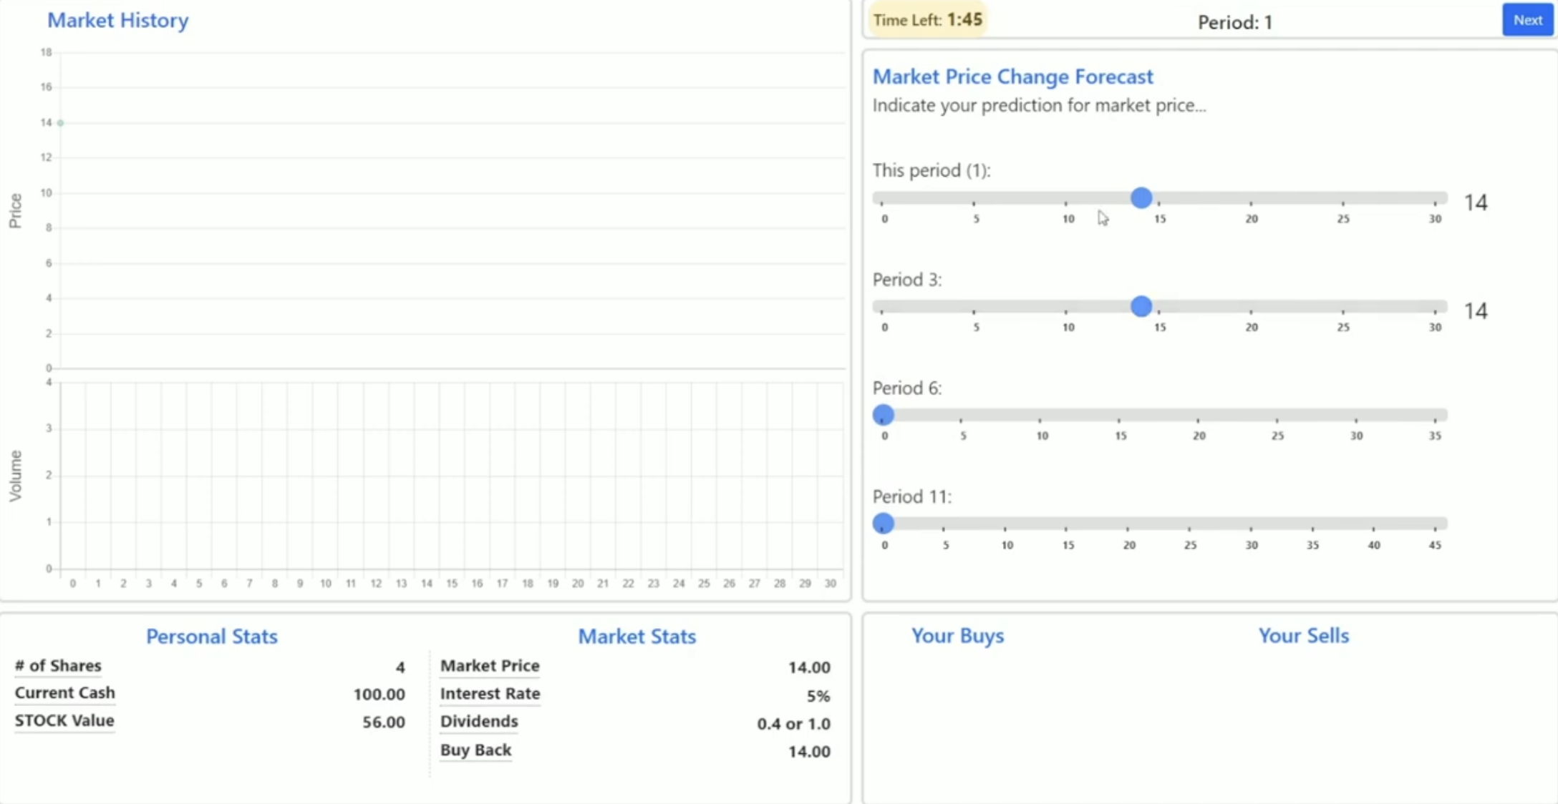
Asset Price Forecasting
A forecast screen where participants submit their expectations with regards to current and future market prices (for 30 seconds)

Slide 10
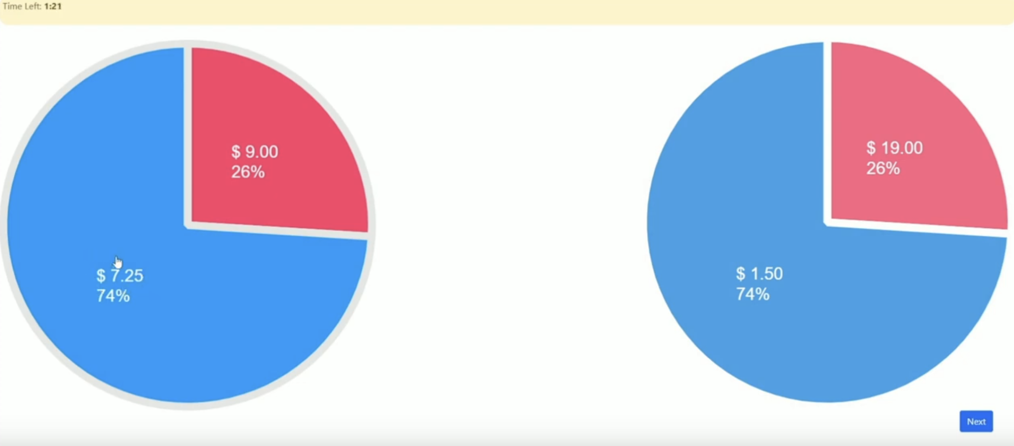
Risk Elicitation Task
A risk-elicitation screen where participants see 4 pairs of lotteries that change as participants select either riskier or less risky lotteries (for 20 seconds). The risk elicitation task is an application of a Dynamically optimized sequential experiment (DOSE) applied to the 10-question set of Holt and Laury (2002), as outlined in Wang, Filiba and Camerer (2010).

Slide 11
Risk Elicitation Task DOSE

Slide 12
Experimental Design
Market Size: 15-25 subjects simultaneously
5 subjects recorded in person with Empatica

Slide 13
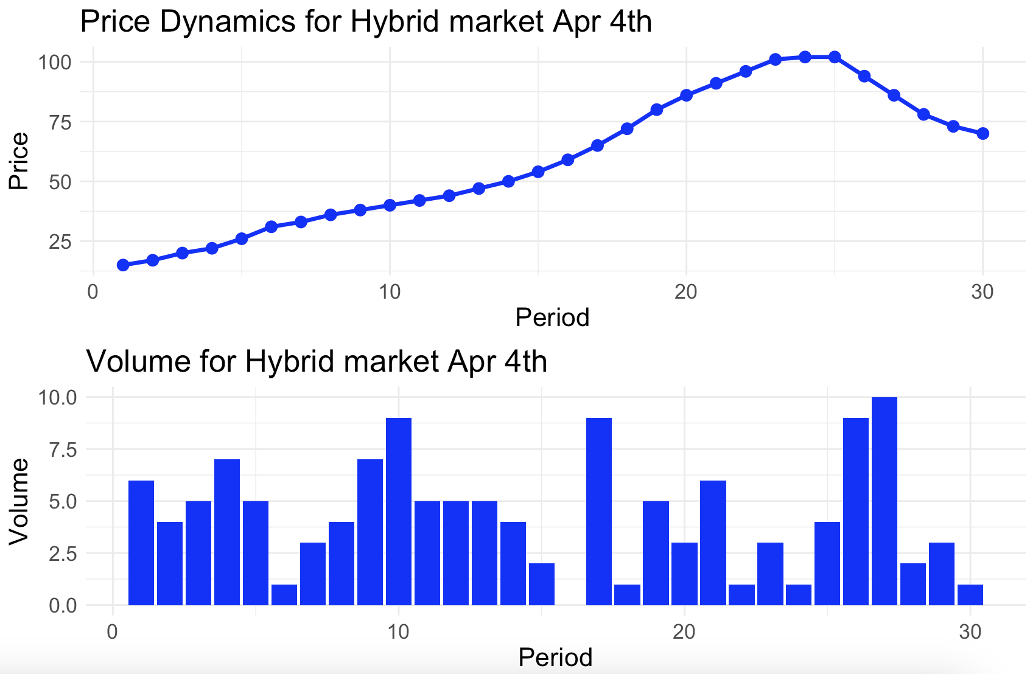
Price and volume dynamics

Slide 14
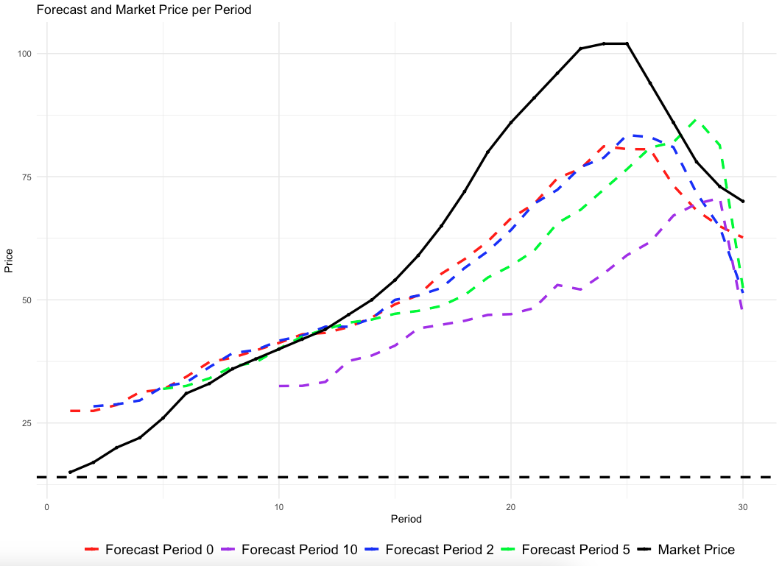
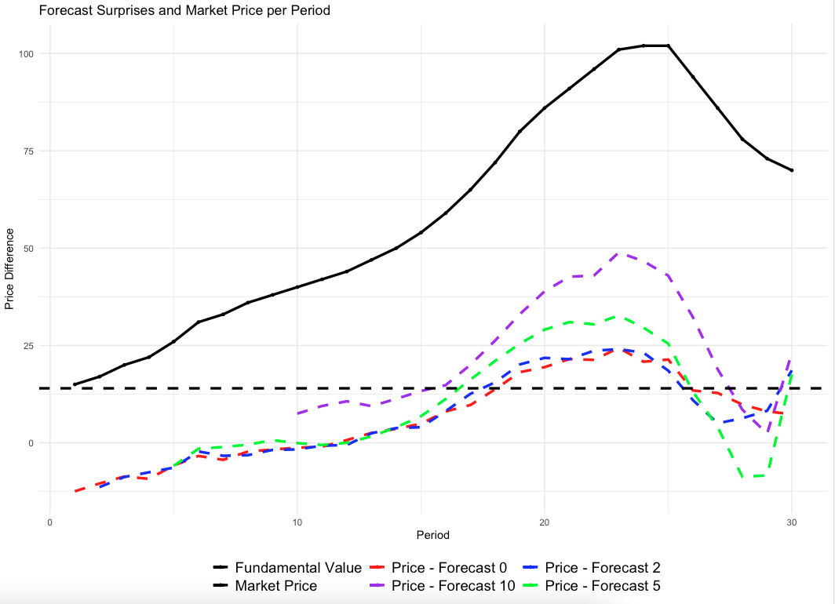
Results – forecast page and forecast surprise
Market price and forecast price
Market price and forecasts differences (P – Forecast)

Slide 15
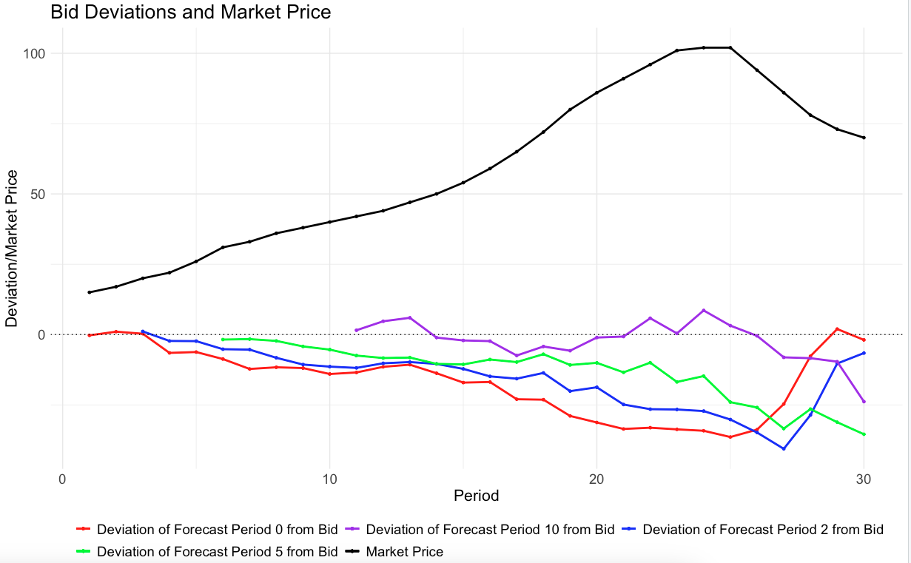
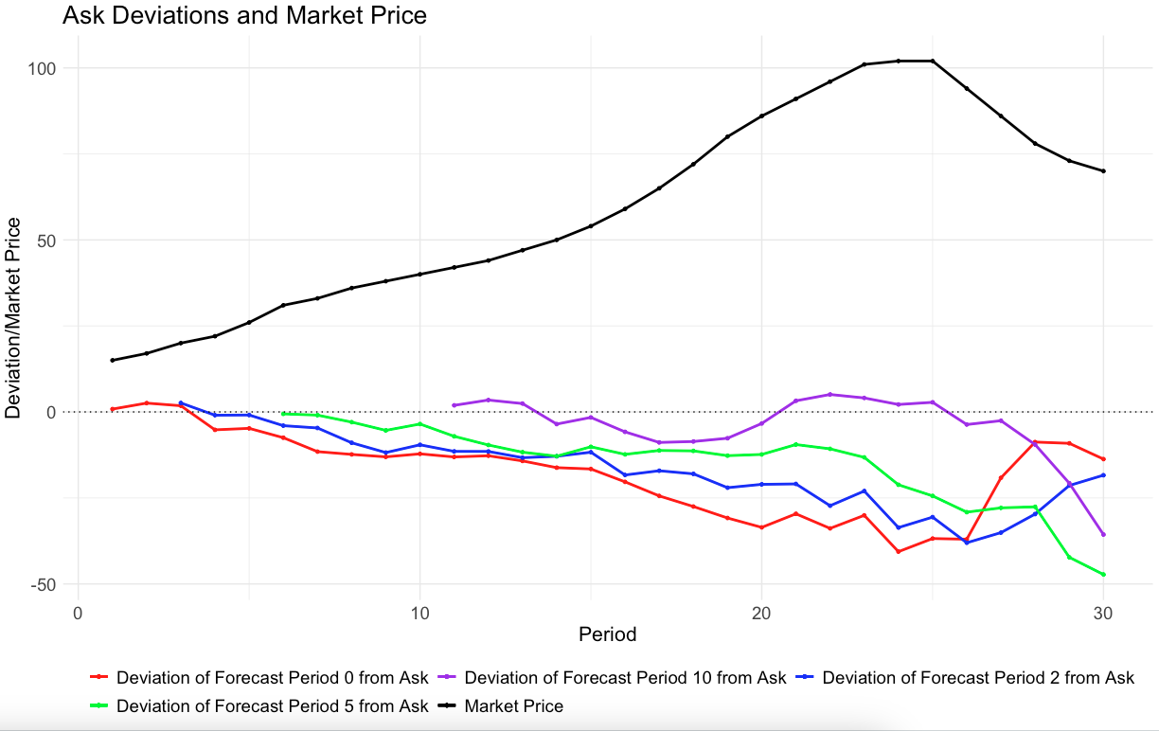
Results – forecast page (rationality check)
Avg. Forecast Period – Avg. Bid
Avg. Ask - Avg. Forecast Period

Slide 16
Results – risk taking parameter R averaged across participants

Slide 17
Results – risk taking parameter Mu averaged across participants

Slide 18
Market price and Avg EDA

Slide 19
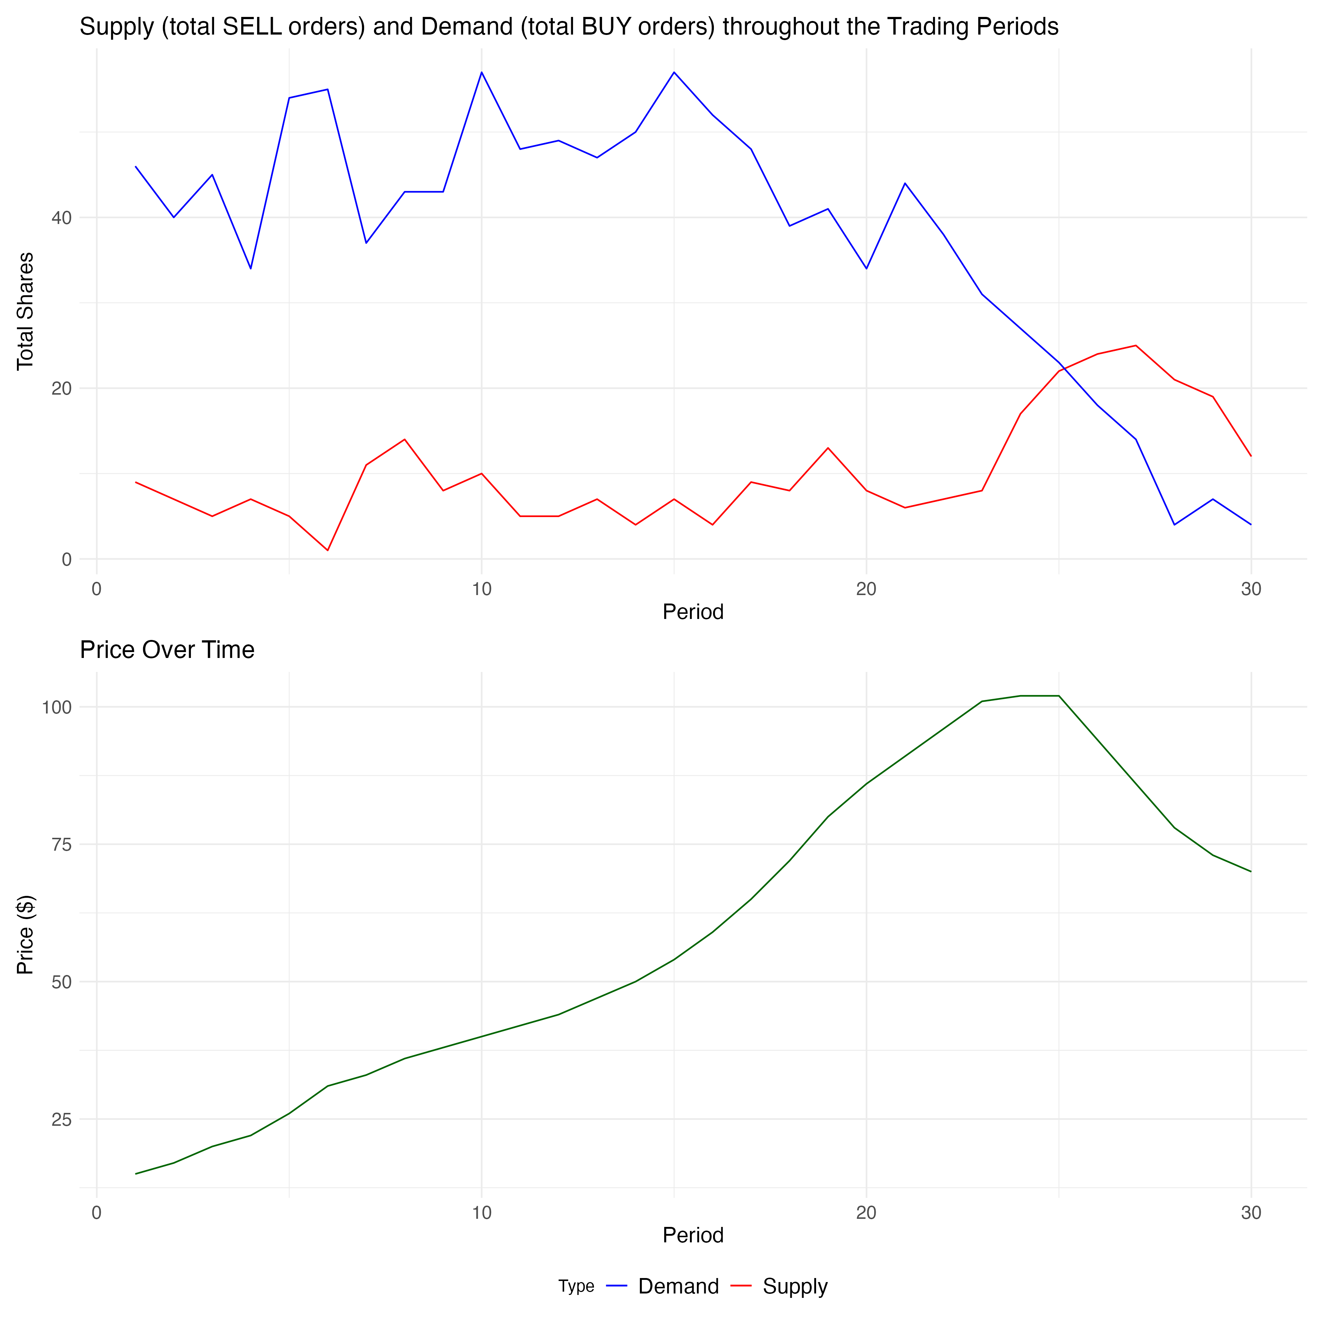
Supply and demand dynamics April 4th

Slide 20
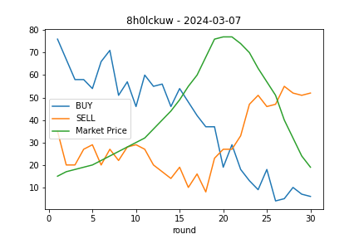
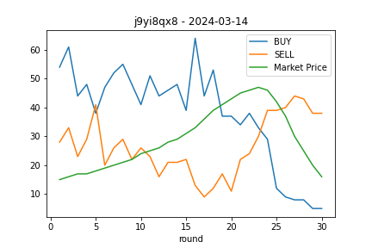
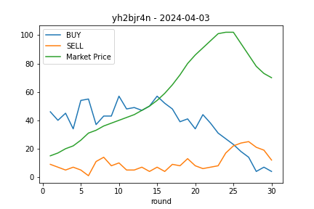
Supply and demand dynamics
March 7th
March 14th
April 4th

Slide 21
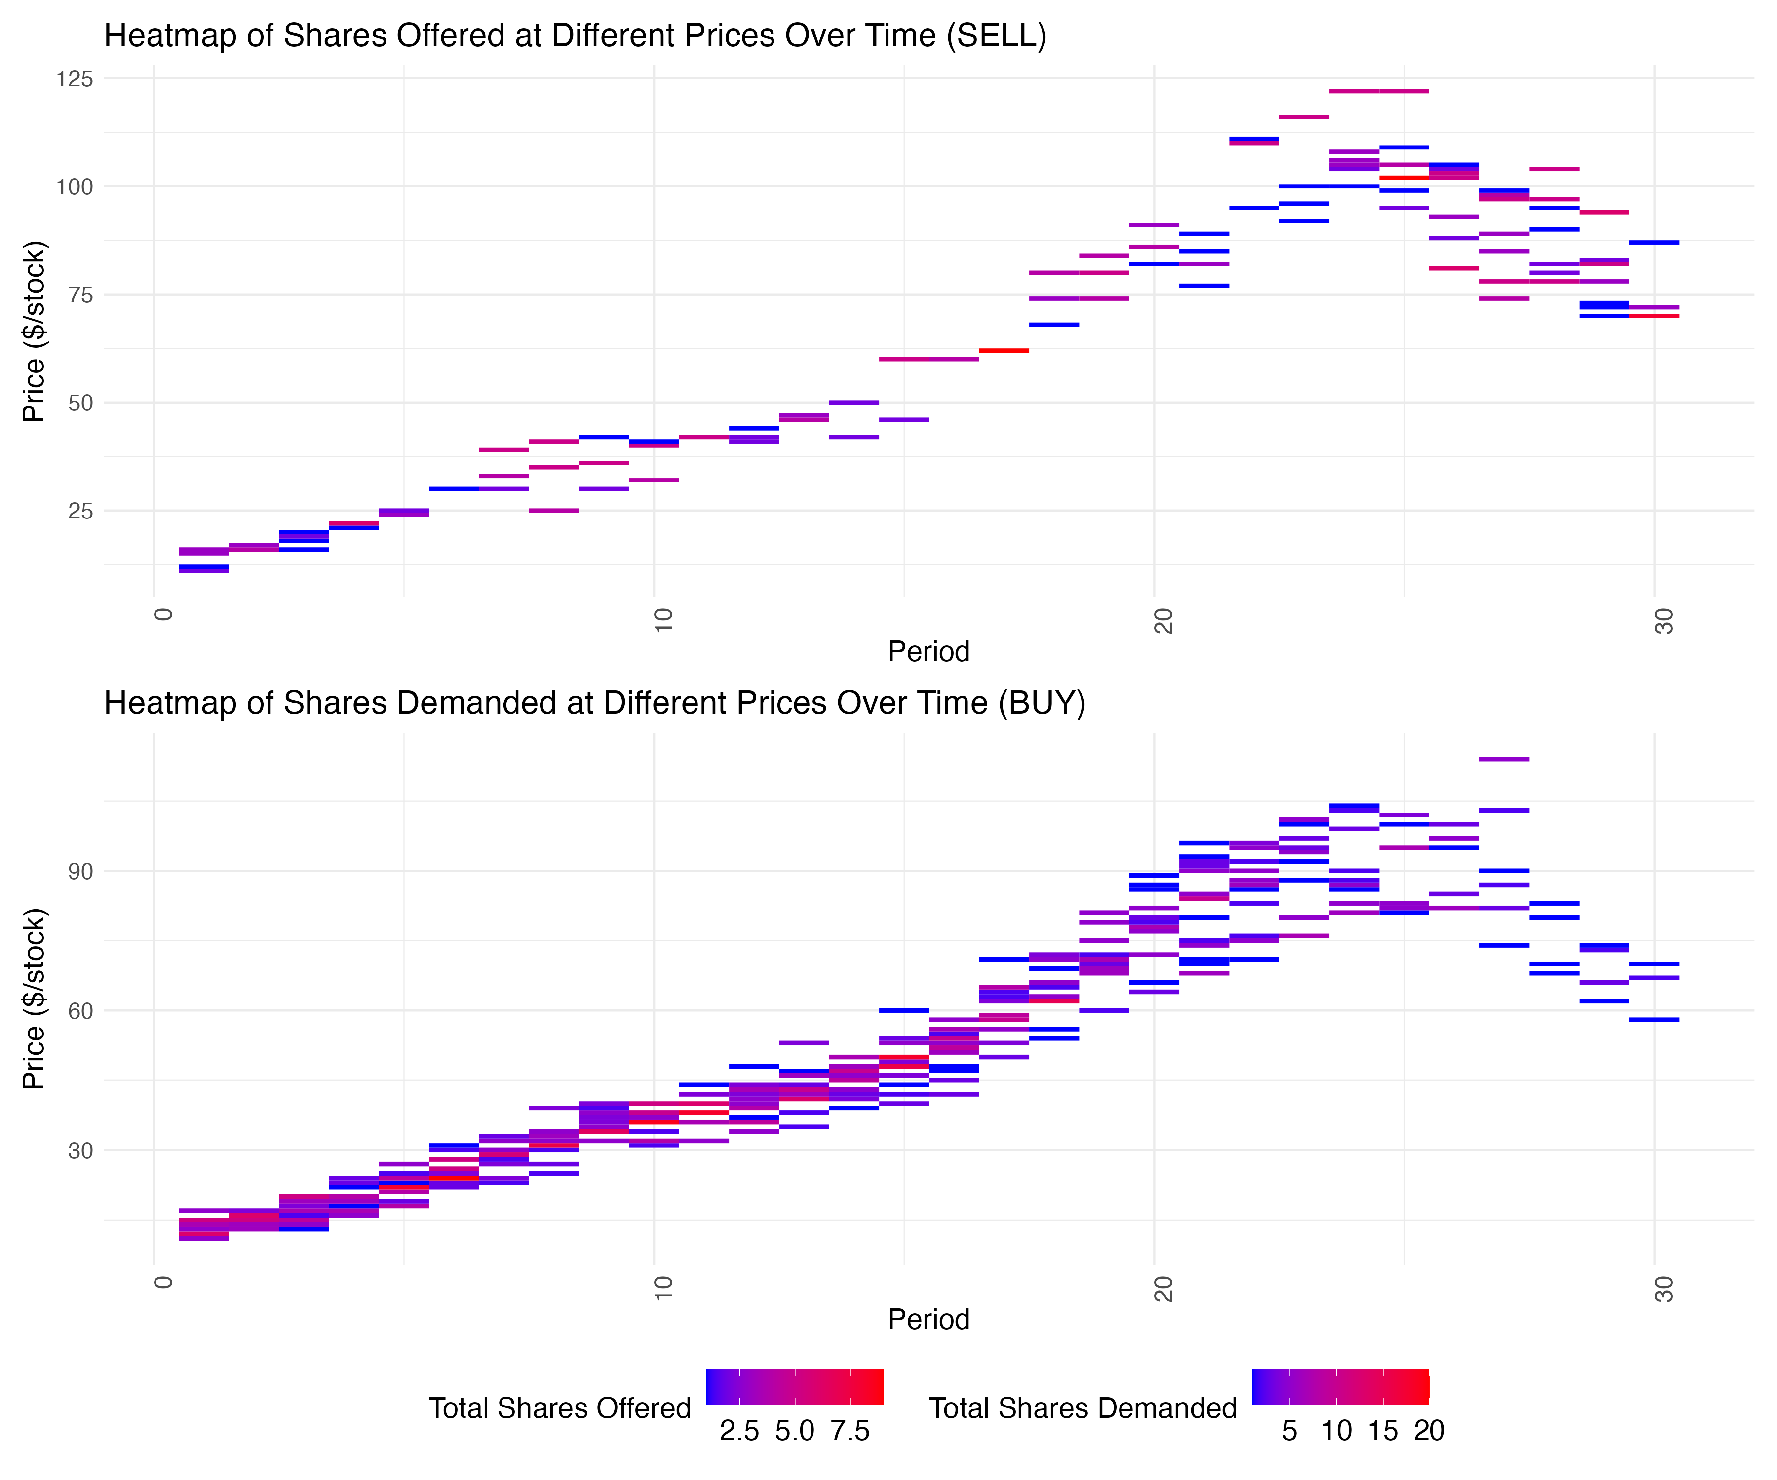
Hybrid 4 April 2024

Slide 22
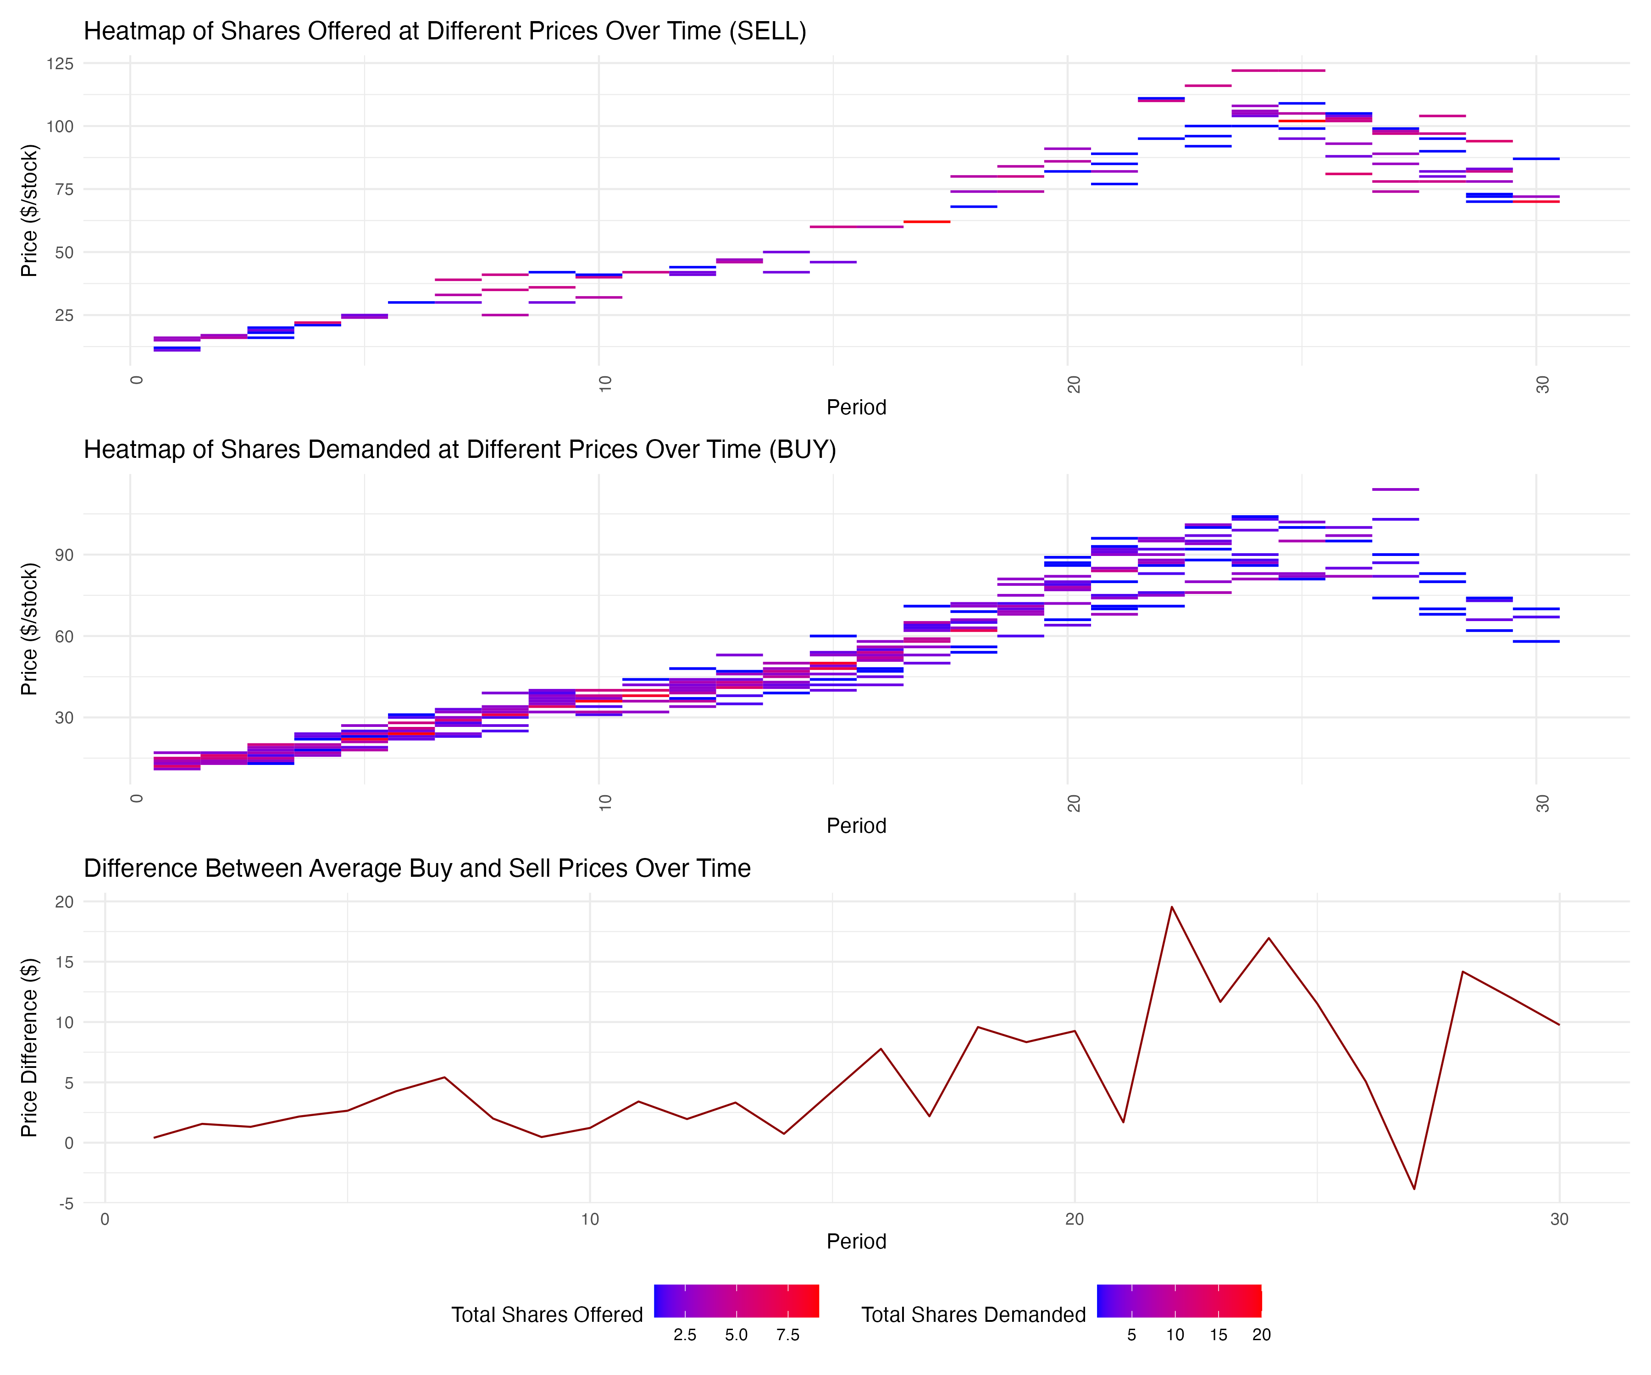
Hybrid 4 April 2024

Slide 23
Summary
Information Asymmetry: Not all participants may have perceived the fundamental value in the same way, or some might have had different information about future prospects, leading to variations in trading behavior.
Supply and Demand Dynamics:
Supply-Demand Divergence (Periods 20-22): As demand begins to fall around period 20-22, supply does not increase correspondingly.
Peak at Period 25: The peak of demand at period 25, while supply continues to be lower and not increase to the same degree as demand was decreasing.
Lack of Sellers at Lower Prices: If many traders are holding stocks hoping for a rebound or are unwilling to sell at lower prices, the supply at the lower price levels could be insufficient to meet any latent demand.
Inelastic Selling: Participants might not have adjusted their selling prices quickly enough to match the declining trend.
Liquidity Constraints: Limited liquidity or the absence of enough market participants.
Proposed solutions:
add another question on fundamental value in the quiz -> that would make a total of 6 questions
underline this information in the video instructions again -> Mihai to do this in Synthesia
emphasize this in the break in between the training and actual trading sessions
make sure we have at least 20 people trading in the market
market maker at the end to “induce” the crash and provide liquidity at around periods 20-25 based on
pre-determined rules?

